Slide 1
Digital Portfolio
STUDENT NAME: M.Theerthagiri
REGISTER NO AND NMID:81E98CF4551C107B36A4CE4A5FBB17D1
DEPARTMENT: B.sc,computer science
COLLEGE: Shanmuga industries arts and science college
UNIVERSITY: Thiruvalluvar University

Slide 2
PROJECT TITLE
Personal Portfolio Website for a Web Designer

Slide 3


AGENDA
Problem Statement
Project Overview
End Users
Tools and Technologies
Portfolio design and Layout
Features and Functionality
Results and Screenshots
Conclusion
Github Link
3/21/2024 Annual Review

Slide 4

PROBLEM STATEMENT
In the digital era, professionals need an online presence to showcase their skills, projects, and services. Many designers and developers rely only on resumes or LinkedIn, which are often limited in customization and creativity. To stand out, there is a need for a personalized, interactive, and responsive portfolio website that not only highlights skills but also attracts clients and employers effectively.

Slide 5

PROJECT OVERVIEW
This project is a personal portfolio website designed to represent the skills, projects, and services of a web designer. The website is fully responsive, user-friendly, and interactive, featuring different sections such as Home, About Me, Projects, Services, Contact, and CV Download. It serves as a professional digital identity and an online resume.

Slide 6

WHO ARE THE END USERS?
The primary end users of this portfolio are: Recruiters & Employers who want to evaluate the developer’s skills and previous work. Clients seeking web design and development services. Peers and Collaborators looking to connect for professional networking.

Slide 7

TOOLS AND TECHNIQUES
The following technologies were used in building the portfolio website: HTML5 → For structuring the web pages. CSS3 → For styling, layout, and responsiveness. JavaScript (Vanilla JS) → For interactivity and dynamic behavior (navigation highlight, animations). CodePen / GitHub → For project hosting and code sharing.

Slide 8
POTFOLIO DESIGN AND LAYOUT
The website follows a modern and minimalistic design with a navy blue theme and white typography. Key design elements include: Fixed navigation bar for smooth scrolling. Circular profile image on the Home section. Grid-based project gallery in the Projects section. Service cards with shadow and hover effects. Contact form for direct communication. Downloadable CV button for quick access to the resume.
8

Slide 9
FEATURES AND FUNCTIONALITY
Smooth Navigation with active link highlighting. Responsive Layout for desktop, tablet, and mobile devices. Interactive Projects Section with hover effects and external links. Social Media Links for professional networking. Contact Form for inquiries and messages. Download CV Feature for recruiters to access resume instantly.

Slide 10
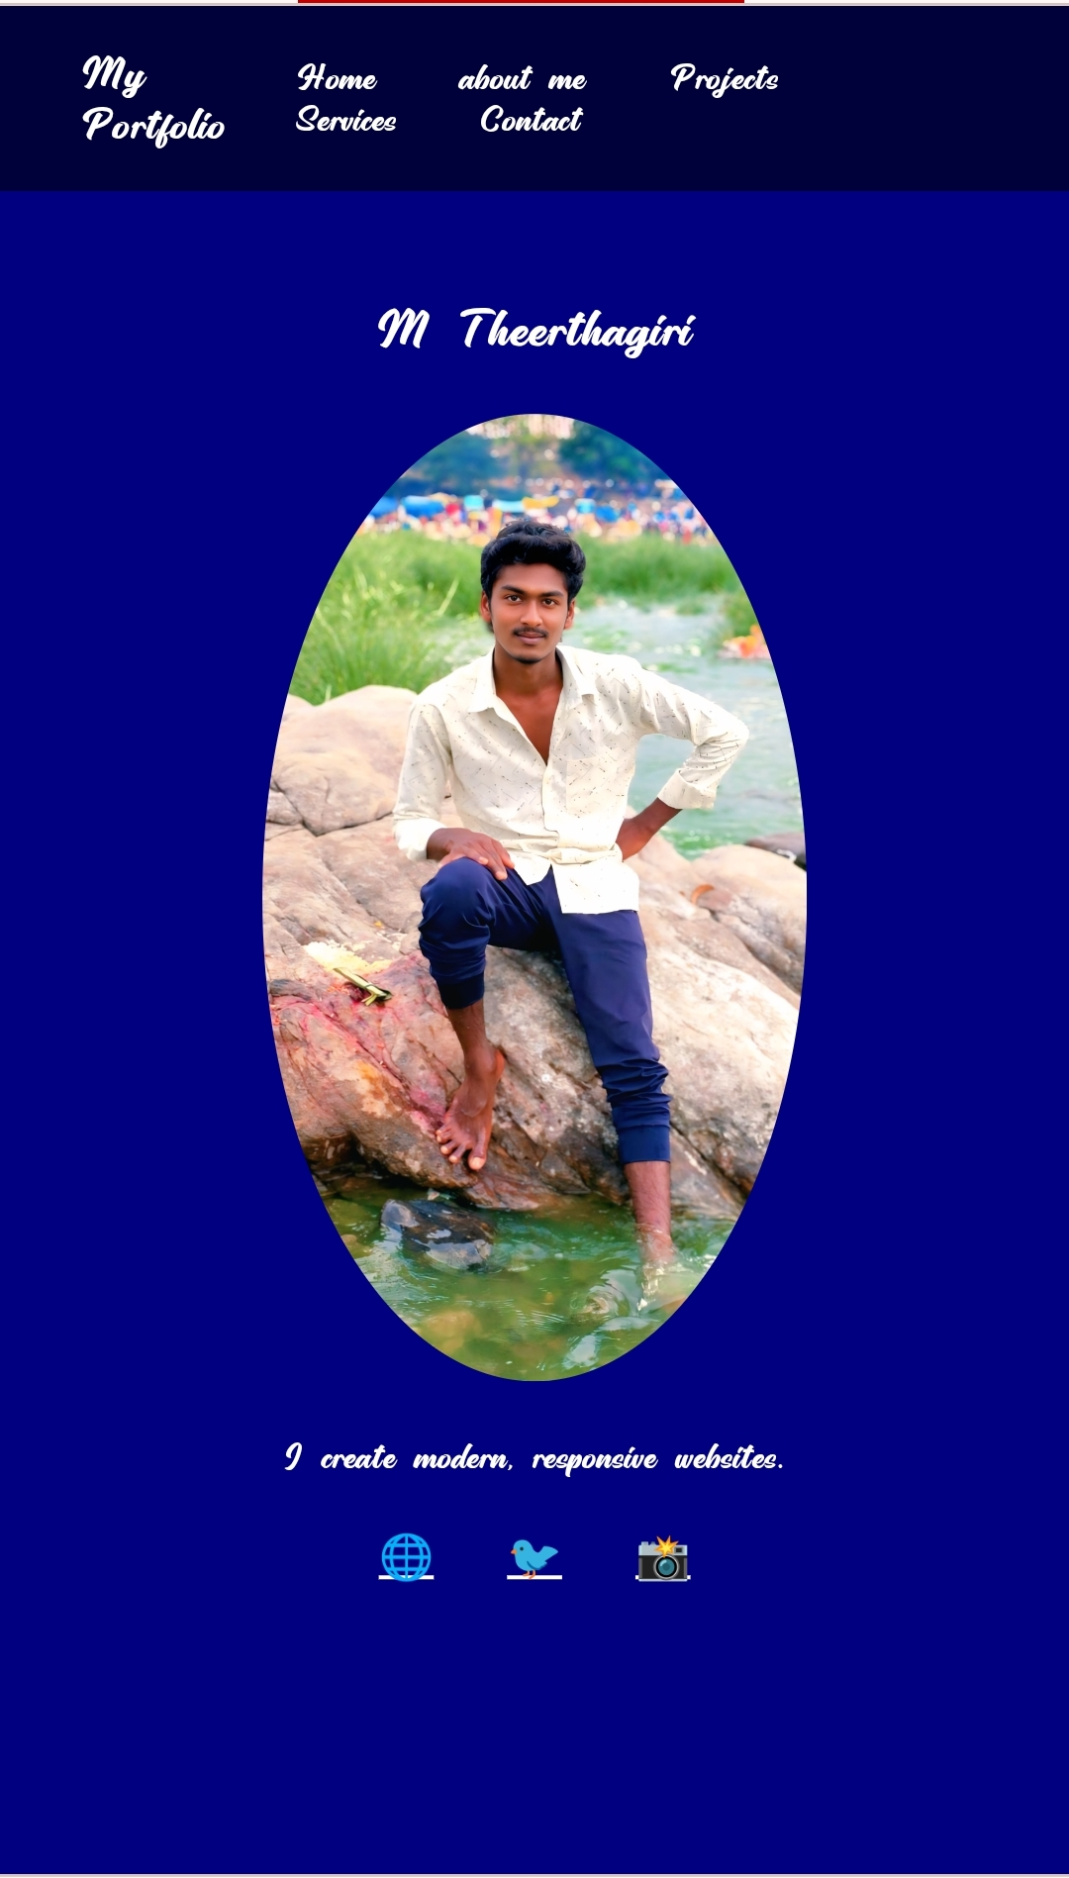
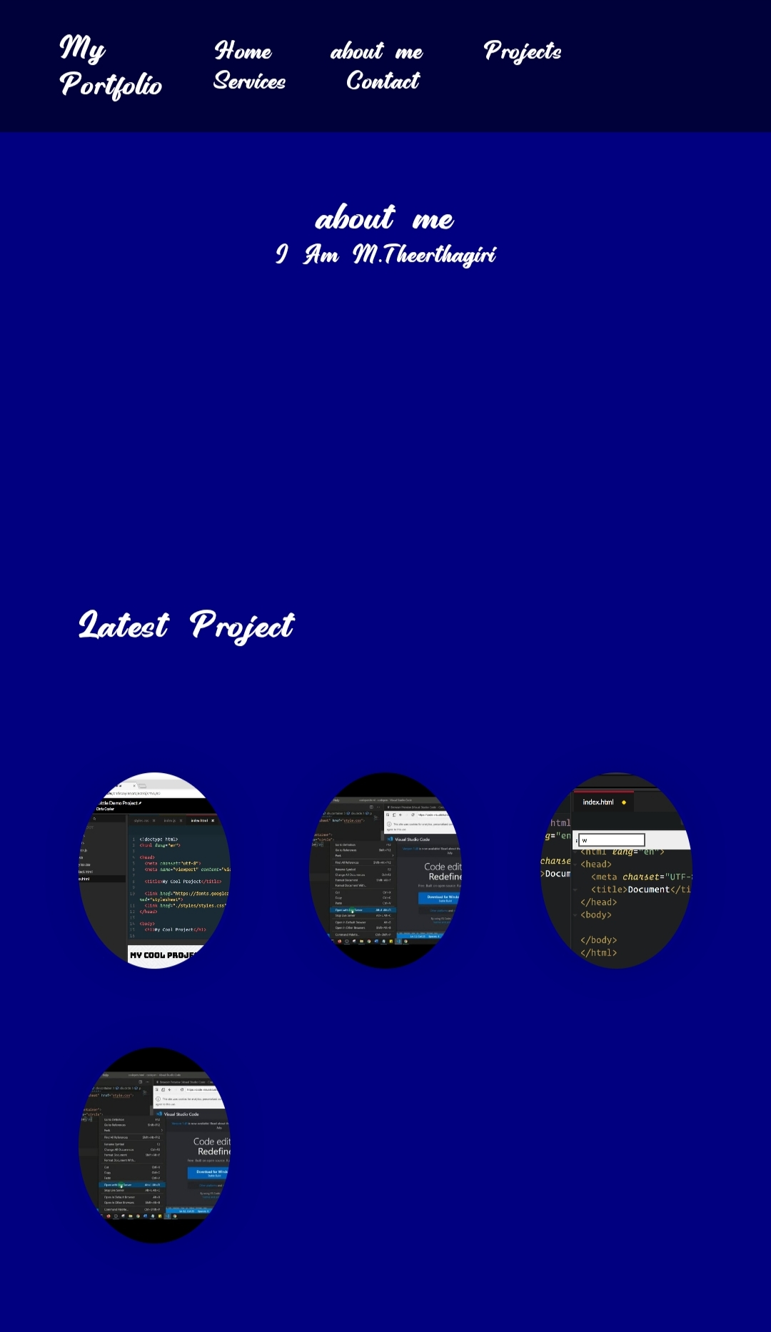
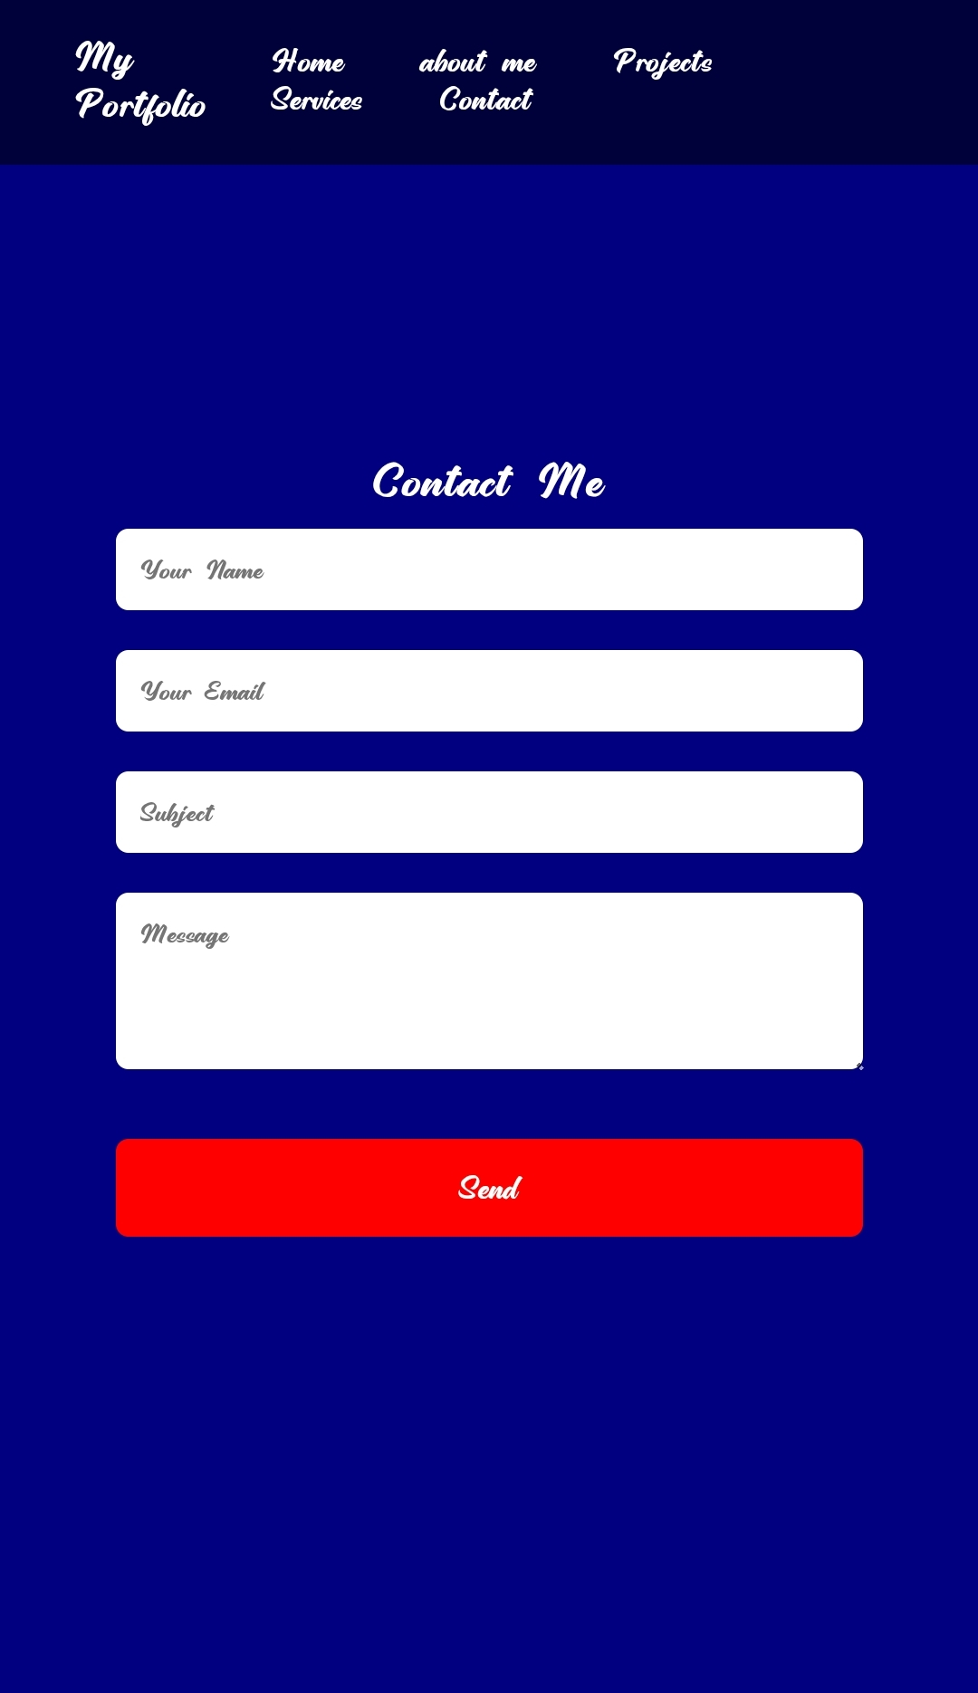

RESULTS AND SCREENSHOTS
3/21/2024 Annual Review
10

Slide 11
CONCLUSION
The portfolio website fulfills its purpose of acting as a digital identity for a web designer. It not only provides an engaging user experience but also highlights professional expertise effectively. Future improvements may include adding a blog section, dark/light mode toggle, and backend integration for the contact form.
11

